Slide 1
ANALYSE IMAGE CLASSIFICATION OF MNIST DATASET
Group Name : CodeCube
Group Members:
Soundarya Talawai
Alam Sher Khan
Aimen Zehra

Slide 2
Contents
INTRODUCTION
HTM SPATIAL POOLER
IMAGE CLASSIFICATION
METHODOLOGY
IMPLEMENTATION
CONCLUSION
REFERENCE

Slide 3
Introduction
Image classification came into existence for decreasing the gap between the computer vision and human vision by training the computer with the data.
Image classification is a challenge that puts a system's intellect to recognize the interpretation of visual information in an image and construct a model that can store such information to the test.
The image classification and the prediction of images is done by evaluation of HTM parameters

Slide 4
HTM Spatial pooler
HTM is a machine learning technique inspired by the neocortex and developed to learn and anticipate sequences
In an end-to-end HTM system, the SP transforms input patterns into SDRs in a continuous online fashion.
The HTM temporal memory learns temporal sequences of these SDRs and do the predictions for future inputs.
Different cells within a mini-column represent this feedforward input in different temporal contexts.
Cells in a mini-column share the same feedforward classical receptive field.
In this way SP models common receptive field is learned from the input.
The SP output define the activation of mini-columns in response to feedforward inputs.

Slide 5
Continuation
A signal layer in an HTM network is structured as a set of mini-columns, each mini-columns consist of a set of cells.
Each SP mini-column forms synaptic connections to a population of input neurons.
The dimensionality of the input space depends on the applications.
At any time, only a small fraction of the mini-columns with the most active inputs become active

Slide 6
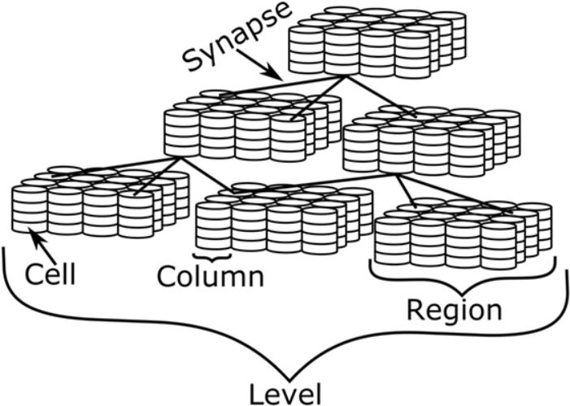
Continuation
Depiction of HTM, showing the various levels of detail Source and typical HTM System

Slide 7
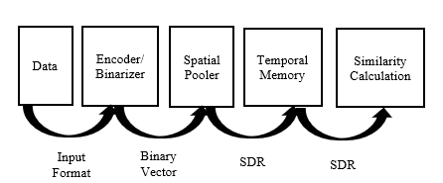
IMAGE CLASSIFICATION
Fig shows the overview of typical HTM System which describes the reference to the methodology of image classification.

Slide 8
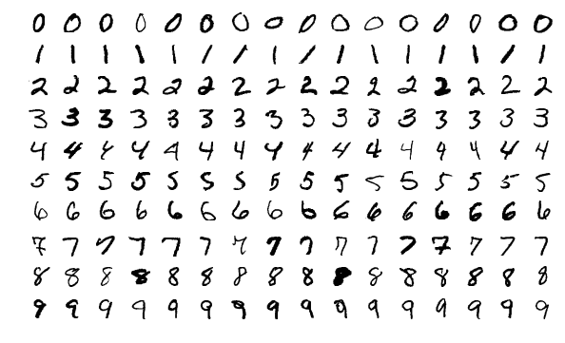
Methodology
The dataset used in this project is MNIST images dataset.
It is a large database of handwritten digits that contains 60,000 training images and 10,000 testing images and is commonly used for training various image processing systems. Following figure shows the sample of MNIST dataset

Slide 9
Continuation
An HTM develops from the data that is given to it, as well as the presentation of that data
An encoder converts arbitrary input into a format that an HTM can understand
The activation state ('0' or '1' for inactive and active, respectively) of the columns from the previous area in the HTM is represented by each bit in the SDR. The input is then used as feed forward input to HTM’s next area.
The Spatial Pooler transforms input patterns into SDRs in a continuous online fashion
The HTM temporal memory learns temporal sequences of these SDRs and makes predictions for future inputs.

Slide 10
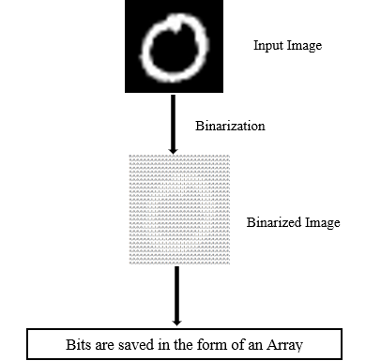
Continuation
Figure depicts the binarization of the MNIST dataset images

Slide 11
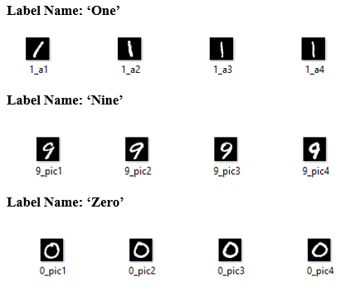
Implementation
Different cases of experiments done on images of handwritten digits obtained from MNIST dataset.
The experiments are performed to analyze the variation in similarity on changing the HTM parameters.
Experiments are also performed to check the accuracy of image prediction after obtaining the best similarity matrix
The figure shows the contents of the input folder

Slide 12
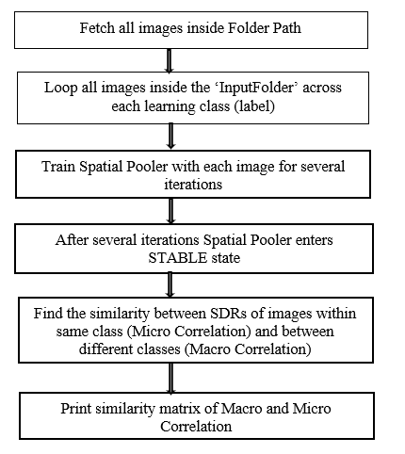
Continuation
Figure shows the flow of image training steps in HTM image classification system.

Slide 13
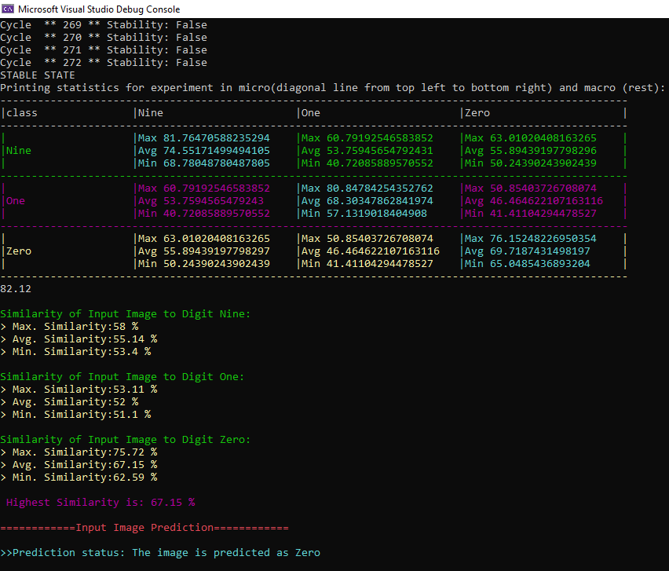
Results and Discussions
Calculated the similarity threshold after conducting many training experiments at various values of LocalAreaDensity and PotentialRadius and observed the similarity between images of different classes (Macro Correlation)
Figure shows the Output of Training and Prediction

Slide 14
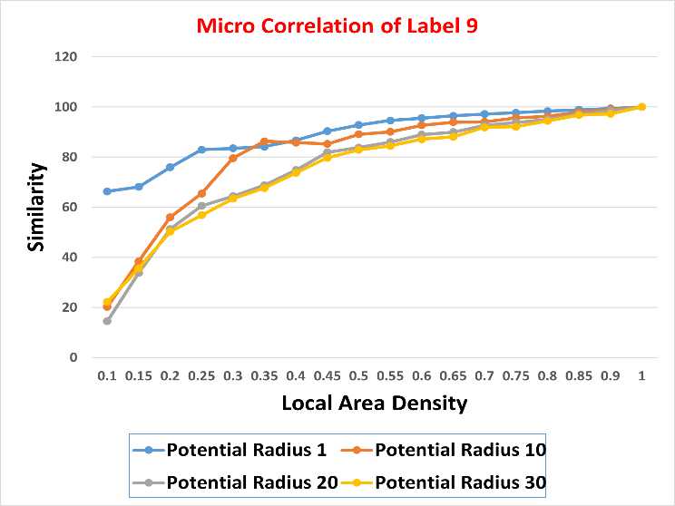
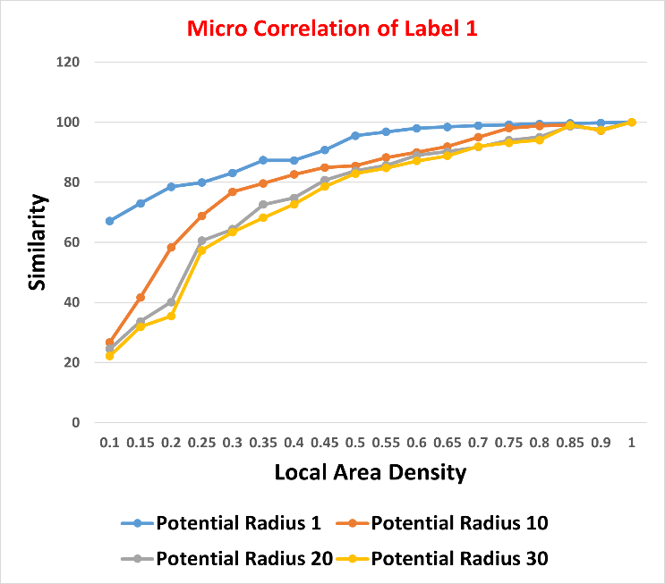
Graphs
Micro Similarity of Label 9 with local area density at potential radius 1,10,20 and 30 in first figure and Micro Similarity of Label ‘1’ with local area density at potential radius 1,10,20 and 30

Slide 15
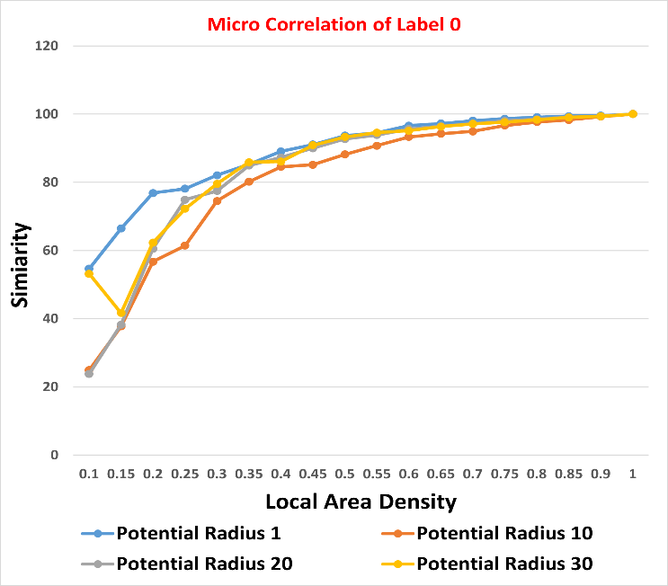
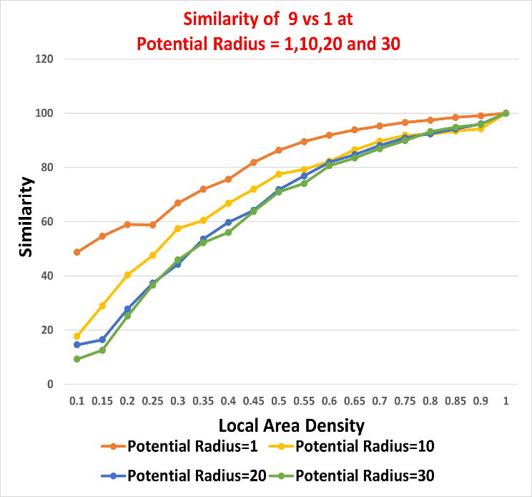
Continuation
First figure shows the Micro Similarity of Label ‘Zero’ with local area density at potential radius 1,10,20 and 30 and the other figure shows the Macro Similarity 9 vs 1 at potential radius 1,10,20 and 30

Slide 16
Continuation
Figure depicts the output of the prediction code

Slide 17
Conclusions
The similarity increases as the local area density is increased and images of same image class and different image class appears to be similar
For local area density value of 1, the image matches 100% irrespective of whatever the image is taken.
Incorporated a similarity threshold in the prediction code which prevented false predictions in case if the image to be predicted does not belong to training dataset.
If large number of columns remain active within a local area inhibition, the similarity between the images will be more and they appear to me similar. So, for the different class of images not to appear similar, the local area density must be as low as possible.

Slide 18
References
[1] J. Mnatzaganian, E. Fokoué and D. Kudithipudi, "frontiers in Robotics and AI," [Online]. Available: https://www.frontiersin.org/articles/10.3389/frobt.2016.00081/full.
[2] "Wikipedia," [Online]. Available: https://en.wikipedia.org/wiki/MNIST_database.
[3] D. Dobric, "Github," [Online]. Available: https://github.com/ddobric/neocortexapi-classification.
[4] G. D, "How the brain might work: a hierarchical and temporal model for learning and recognition," Stanford University, Stanford, CA, USA, 2008.
[5] J. Hawkins, S. Ahmad and D. Dubinsky, "Hierarchical Temporal Memory including HTM Cortical Learning".
[6] "Numenta," [Online]. Available: https://numenta.com/resources/biological-and-machine-intelligence/spatial-pooling-algorithm/.
[7] J. Hawkins and C. Maver, "Biological and Machine Intelligence," BAMI, 2019. [Online]. Available: https://numenta.com/assets/pdf/biological-and-machine-intelligence/BaMI-HTM-Overview.pdf.

